Slide 1
Introduction to
International Business Administration

Slide 2
The Foreign Exchange Market and Monetary System
Notes:
This is a test

Slide 3
Prof. Dr. Amit Shah
Notes:
This is a test

Slide 4
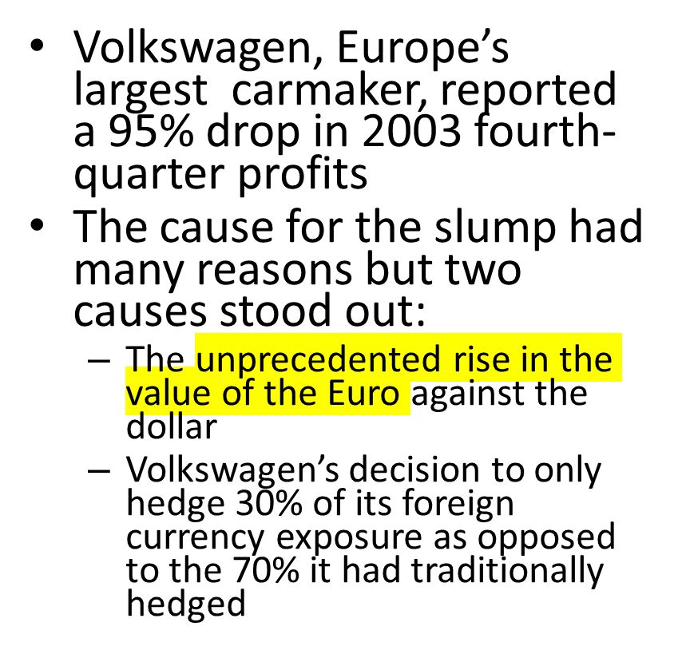

Volkswagen’s Hedging Strategy
Notes:
For Volkswagen, which made cars in Germany and exported them to the United States, the fall in the value of the dollar against the euro during 2003 was devastating. To understand what happened, consider a Volkswagen Jetta built in Germany for export to the United States. The Jetta costs m14,000 to make in Germany and ship to a dealer in the United States, where it sells for $15,000. With the exchange rate standing at around m1 $1.00, the $15,000 earned from the sale of a Jetta in the U.S. could be converted into m15,000, giving Volkswagen a profit of m1,000 on every Jetta sold. But if the exchange rate changes during the year, ending up at m1 $1.25 as it did during 2003, each dollar of revenue will now buy only m0.80 (m1/$1.25 m0.80), and Volkswagen is squeezed. At an exchange rate of m1 $1.25, the $15,000 Volkswagen gets for the Jetta is now only worth m12,000 when converted back into euros, meaning the company will lose m2,000 on every Jetta sold (when the exchange rate is m1 $1.25, $15,000/1.25 m12,000).
Bringing money over to Europe gives you less profits when the euro is highly valued

Slide 5
The Foreign Exchange Market
Form and function of the foreign exchange market
Difference between spot and forward rates
Determinants of currency exchange rates
Foreign exchange risk and the exchange market
Exchange rate forecasting
Convertibility of currencies
Relationship between monetary system and foreign exchange rates
Historical development
Fixed vs floating exchange rates
Role of the IMF and World Bank

Slide 6
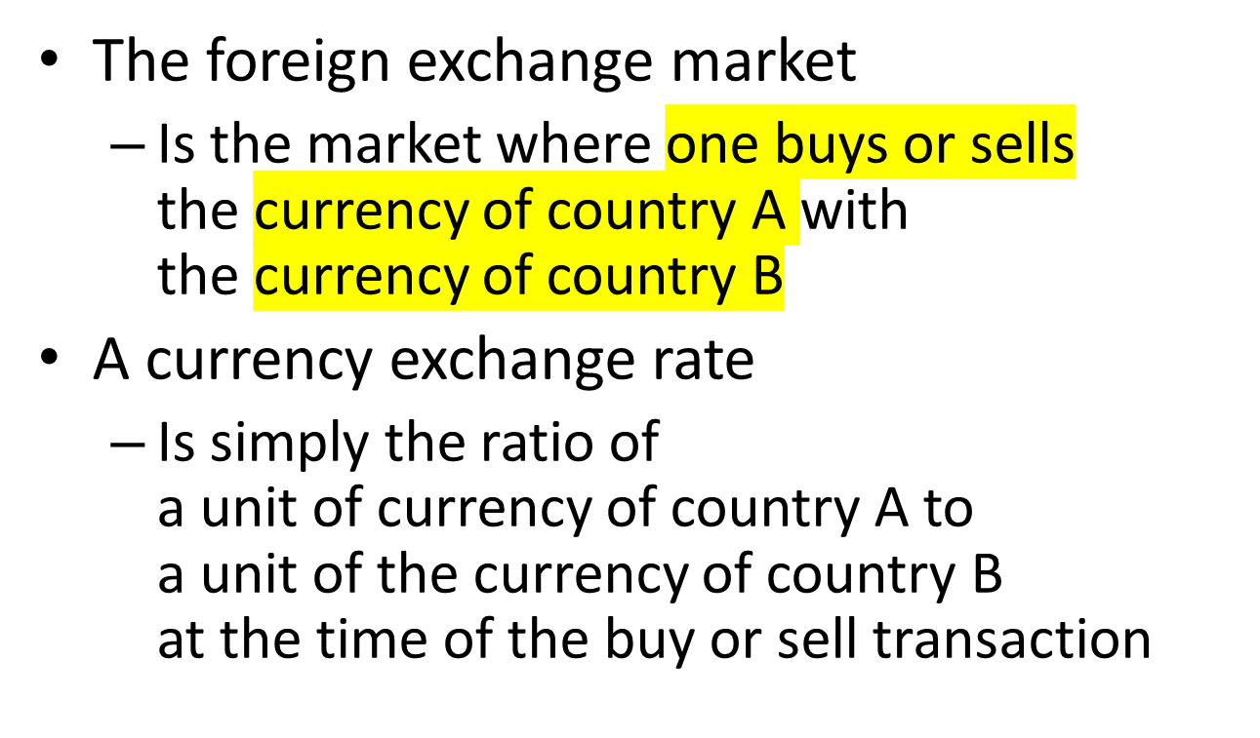
Foreign Exchange
Notes:
Foreign exchange market: changing the currency (Geldwechseln)
Exchange rate: how much of B you get for A

Slide 7
Exchange Rates, 5 December 2022
Euro | 1.00 EUR buys | EUR to buy 1.00
US Dollar | 1.051 | 0.95
British Pound | 0.86 | 1.16
Indian Rupee | 85.69 | 0.01
Australian Dollar | 1.57 | 0.64
Canadian Dollar | 1.43 | 0.70
Japanese Yen | 143.19 | 0.01
Swiss Franc | 0.99 | 1.01

Slide 8
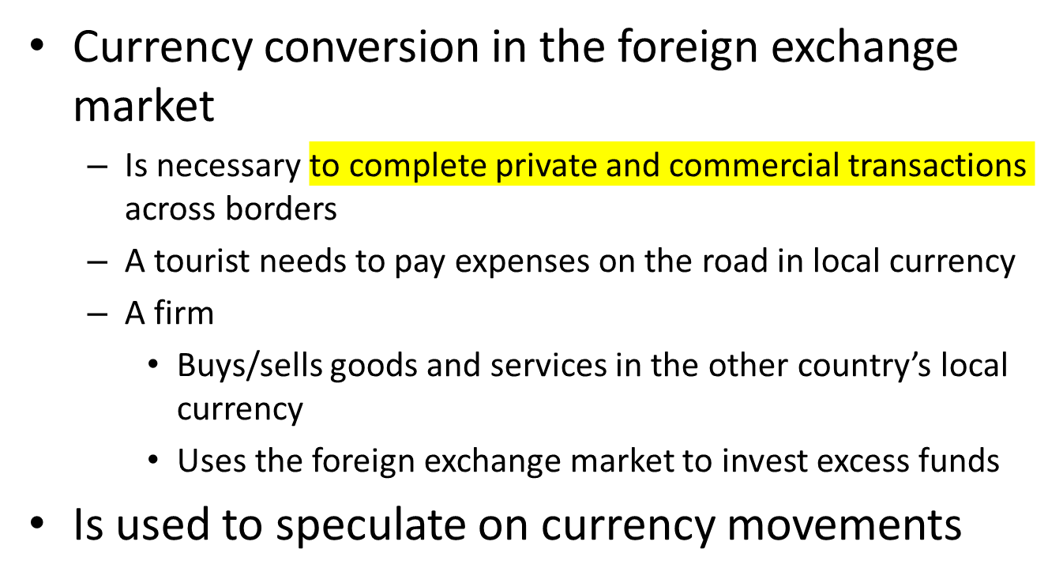
The Foreign Exchange Market
Notes:
Currency used to speculate → buy low and sell high → called hedging

Slide 9
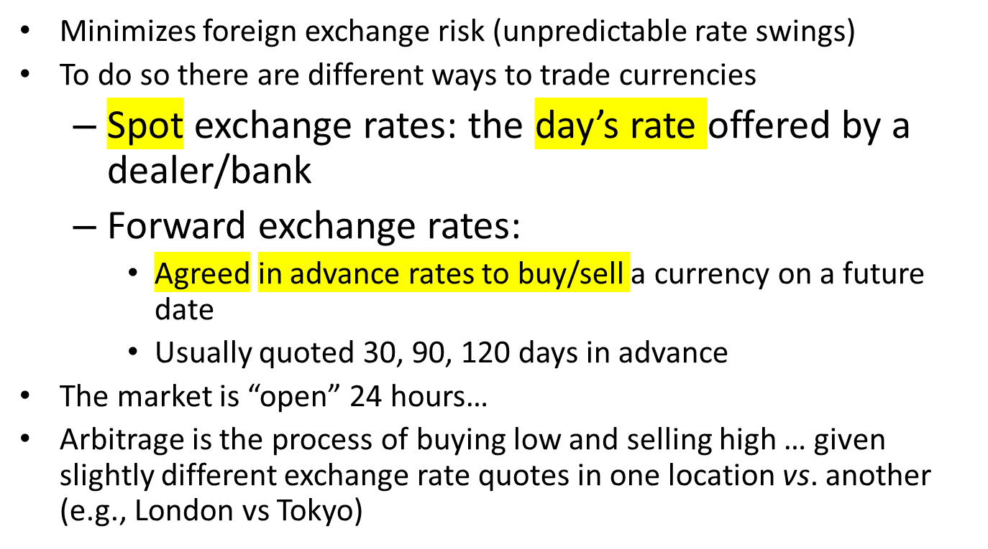
The Foreign Exchange Market

Slide 10
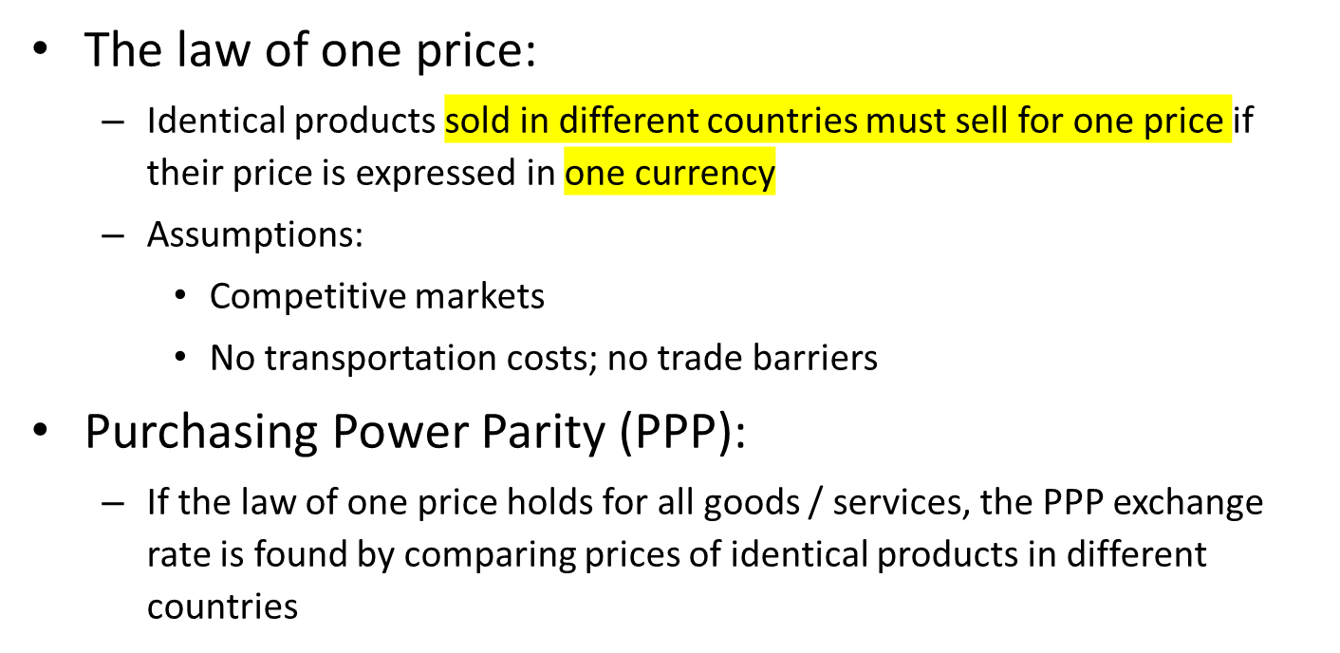
What Should Exchange Rates Be?

Slide 11
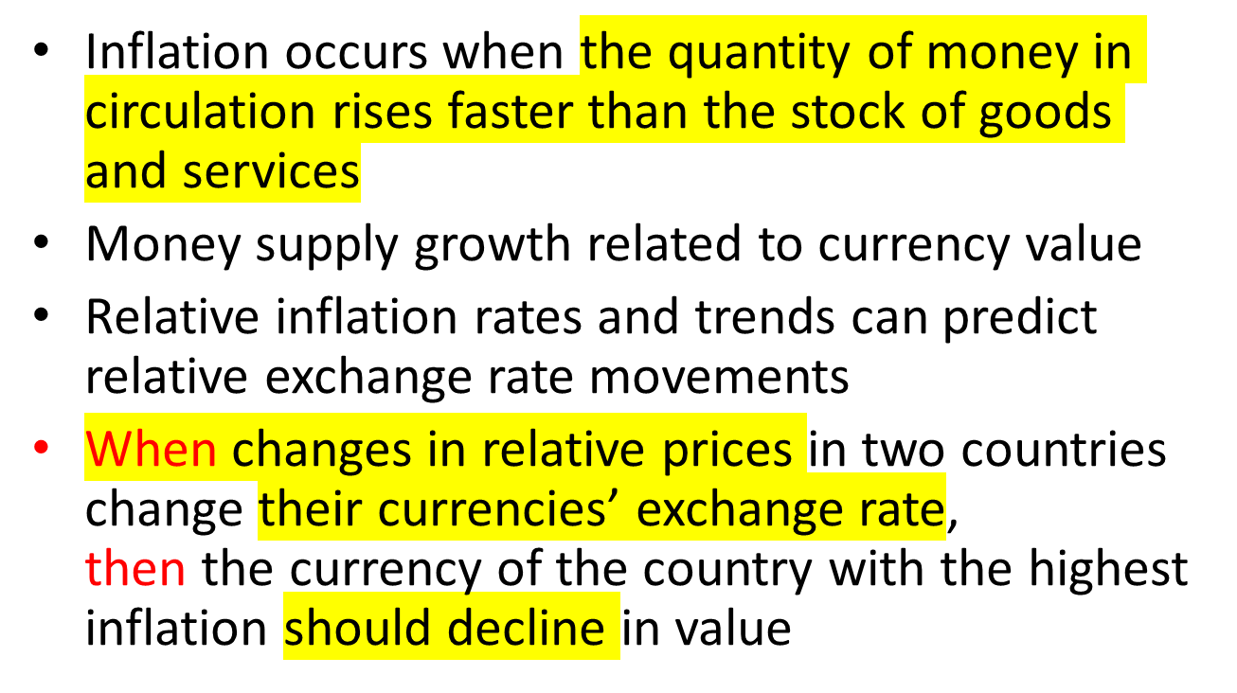
Money Supply and Currency Value
Notes:
Quantity of money (how much money) rises faster than quantity of goods and services

Slide 12
Interest Rates and Exchange Rates
Interest rates reflect expectations of inflation rates
  high interest rates reflect high inflation expectations
Notes:
Stockmarkets decline, when interest rates are raised

Slide 13
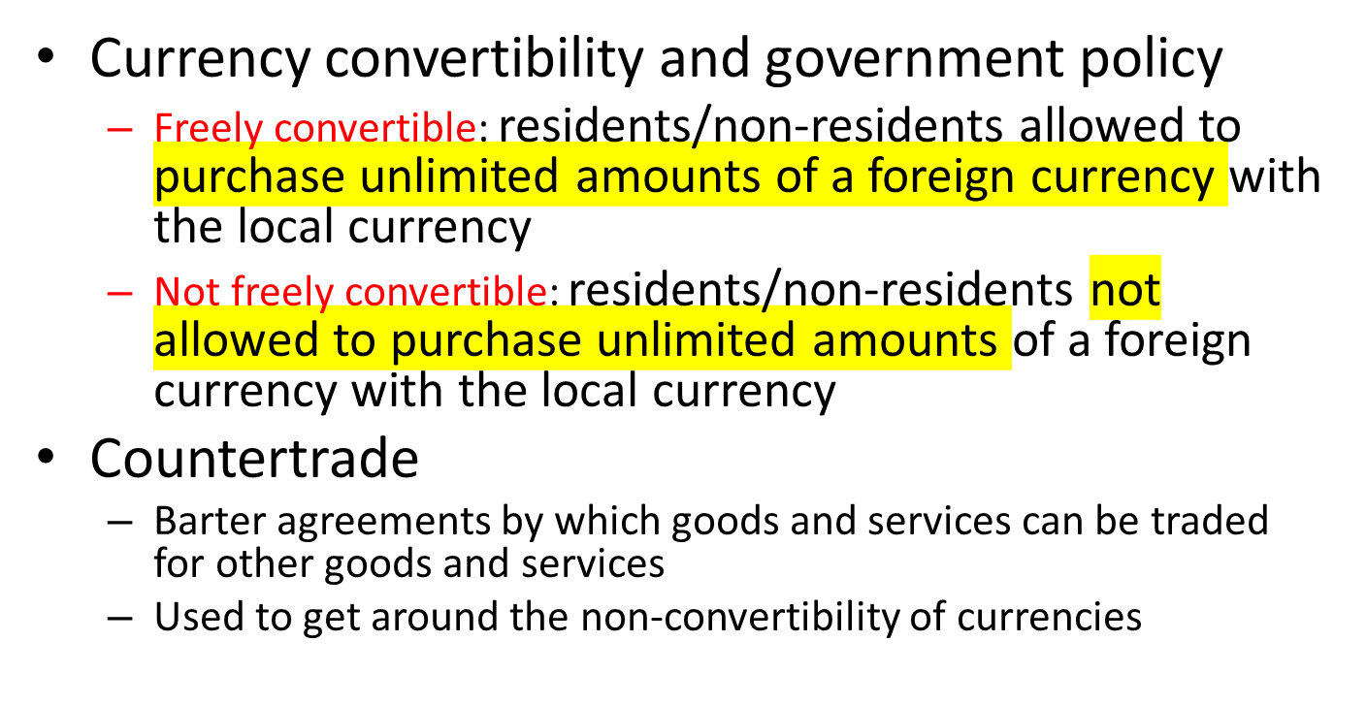
Convertibility
Notes:
Countertrade = trading with non-convertible currencies
Bartering happens in small/medium business locally also → changing things (massages vs. Food)

Slide 14
Types of Exchange Rate Exposure
Transaction exposure
Translation exposure
Economic exposure
Notes:
Transaction = at the time of the transaction
Translation = bringing money over (e.g. profits)

Slide 15
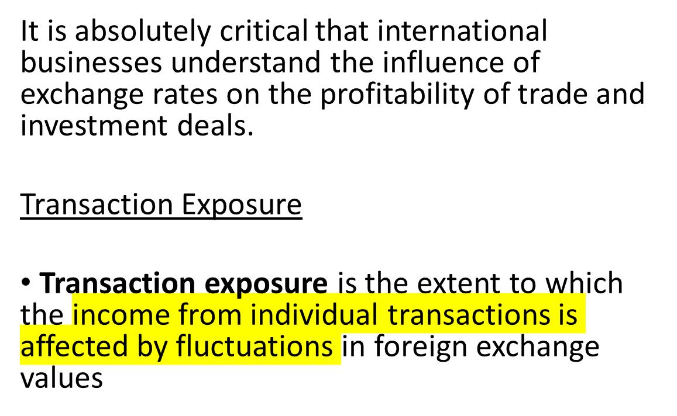
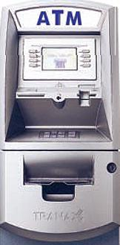
Transaction Exposure
Notes:
Weaker currency = better for exporting goods

Slide 16
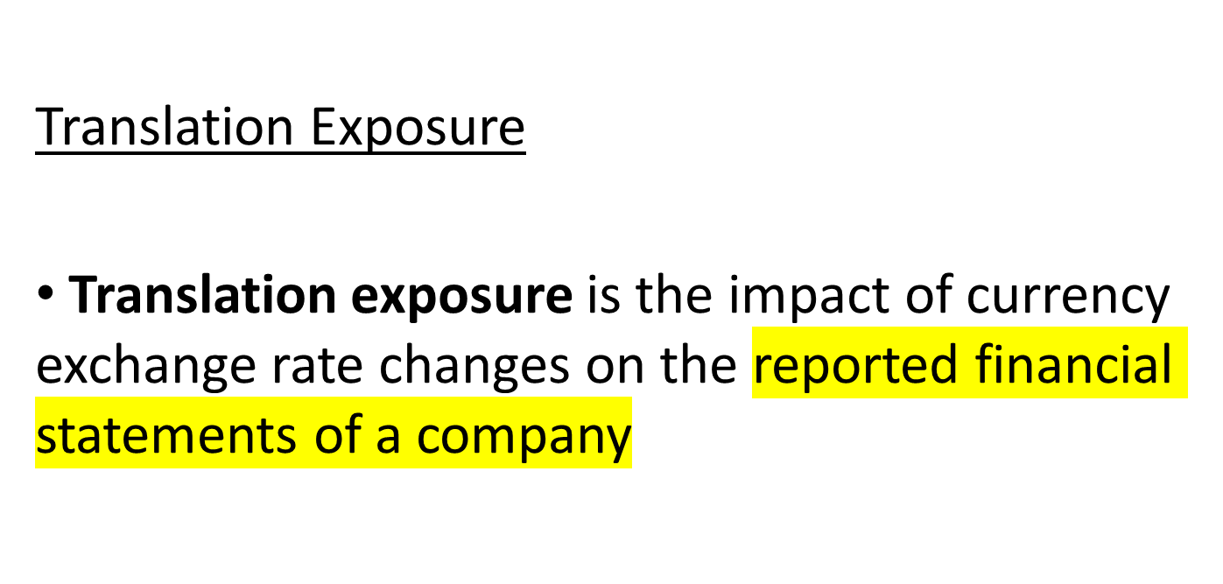
Translation Exposure
Notes:
When the company brings over money so that the report is in a certain currency

Slide 17
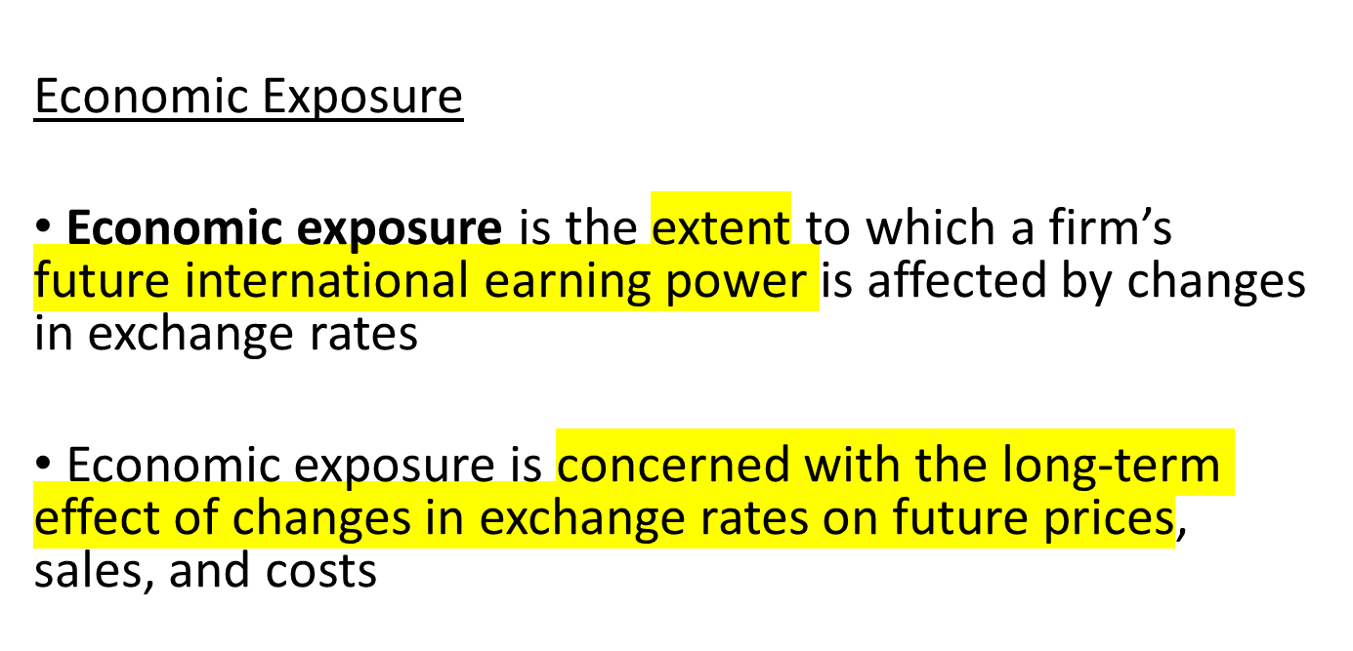
Economic Exposure
Notes:
Appreciation = currency becomes stronger

Slide 18
IMPLICATIONS FOR MANAGERS
How do you minimize exchange rate risk?

Slide 19
Reducing Translation and Transaction Exposure
Firms can minimize their foreign exchange exposure by:
buying forward, using swaps or buying options.
leading and lagging payables and receivables (paying suppliers and collecting payment from customers early or late depending on expected exchange rate movements) [This is what the books say. This is stupid!]

Slide 20
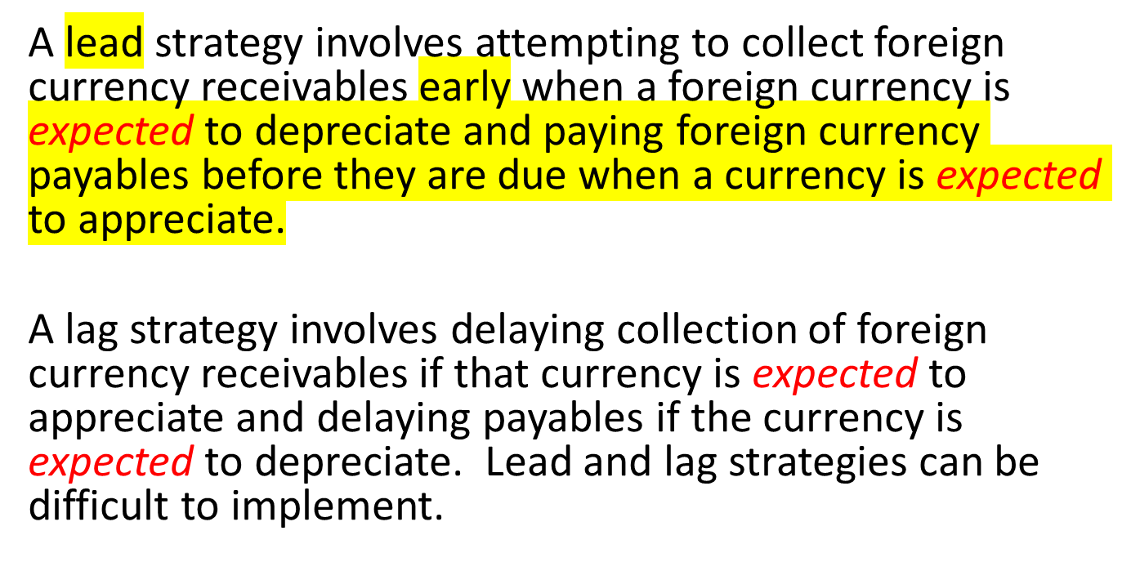
Reducing Translation and Transaction Exposure

Slide 21
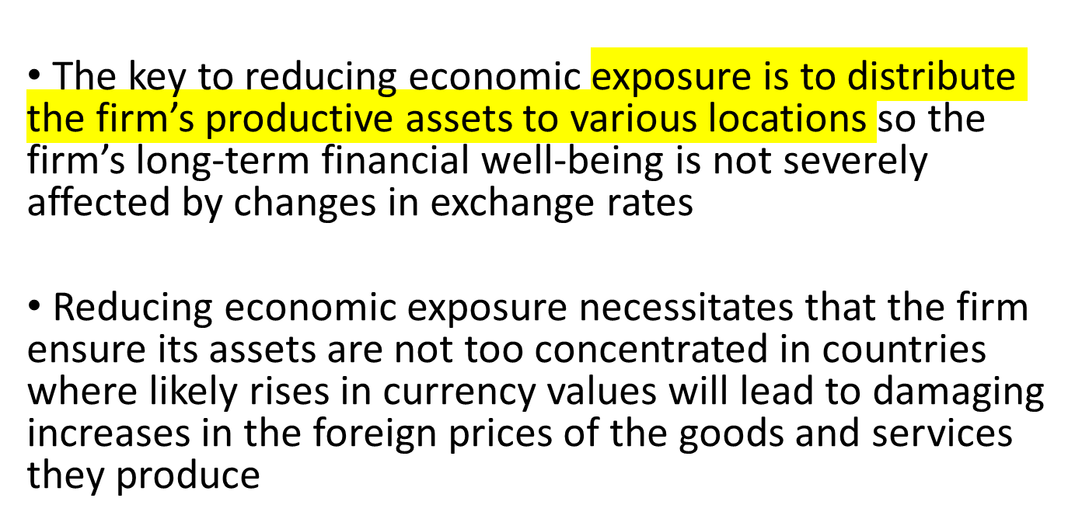
Reducing Economic Exposure

Slide 22
Other Steps for Managing Foreign Exchange Risk
central control of exposure is needed to protect resources efficiently and ensure that each subunit adopts the correct mix of tactics and strategies
firms should distinguish between transaction and translation exposure on the one hand, and economic exposure on the other hand
firms should attempt to forecast future exchange rates
firms need to establish good reporting systems so the central finance function can regularly monitor the firm’s exposure position
firms should produce monthly foreign exchange exposure reports

Slide 23
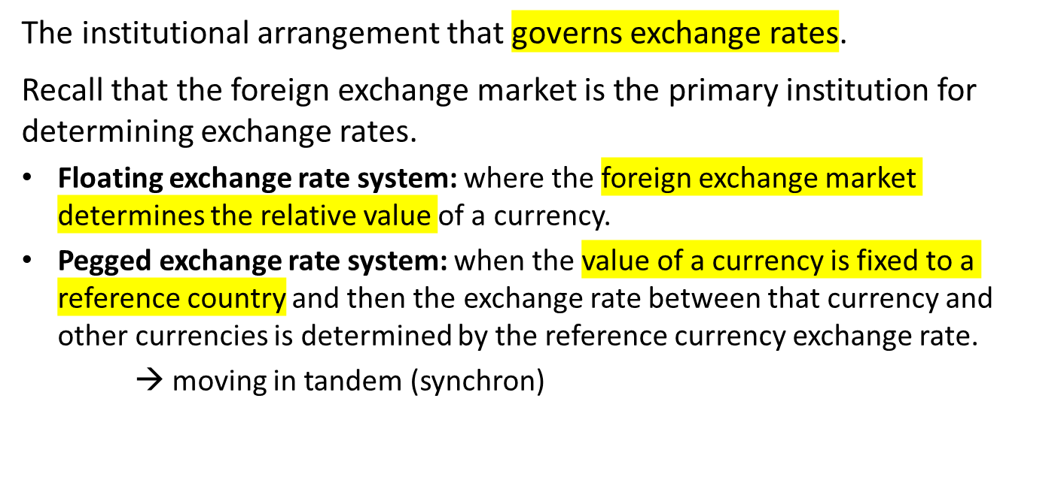
The International Monetary System
Notes:
Four of the world’s major trading currencies—the U.S. dollar, the European Union’s euro, the Japanese yen, and the British pound—are all free to float against each other. Thus, their exchange rates are determined by market forces and fluctuate against each other day to day, if not minute to minute. However, the exchange rates of many currencies are not determined by the free play of market forces; other institutional arrangements are adopted.

Slide 24
The Gold Standard
Origin of the Gold Standard
  Dates to ancient times when gold coins were a medium of exchange, unit of account, and store of value.
  To facilitate trade, a system was developed so that payment could be made in paper currency that could then be converted to gold at a fixed rate of exchange.
Notes:
When international trade was limited in volume, payment for goods purchased from another country was typically made in gold or silver. However, as the volume of international trade expanded in the wake of the Industrial Revolution, a more convenient means of financing international trade was needed.

Slide 25
The Gold Standard
Mechanics of the Gold Standard
  The gold standard is the practice of pegging currencies to gold and guaranteeing convertibility.
    Under the gold standard, one U.S. dollar was defined as equivalent to 23.22 grains of "fine” (pure) gold.
    The exchange rate between currencies was based on the gold par value: the amount of a currency needed to purchase one ounce of gold.
Notes:
Pegging currencies to gold and guaranteeing convertibility is known as the gold standard. By 1880, most of the world’s major trading nations—including Great Britain, Germany, Japan, and the United States—had adopted the gold standard.
Then later : gold removed from the equation = 4.1 pound for one ounce; 7 dollars for one ounce → 4.1 equals 7 dollars e.g

Slide 26
The Gold Standard
Strength of the Gold Standard
  Key strength was its powerful mechanism for simultaneously allowing all countries to achieve balance-of-trade equilibrium.
    When the income a country’s residents earn from its exports is equal to the money its residents pay for imports.
Notes:
This adjustment mechanism seems so simple and attractive that even today, nearly 80 years after the final collapse of the gold standard, some people believe the world should return to a gold standard.

Slide 27
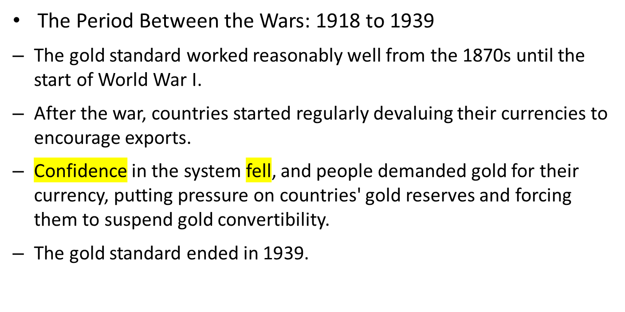
The Gold Standard
Notes:
The net result of market volatility was the shattering of any remaining confidence in the system. With countries devaluing their currencies at will, one could no longer be certain how much gold a currency could buy. Instead of holding onto another country’s currency, people often tried to change it into gold immediately, lest the country devalue its currency in the intervening period. This put pressure on the gold reserves of various countries, forcing them to suspend gold convertibility. By the start of World War II in 1939, the gold standard was dead.

Slide 28
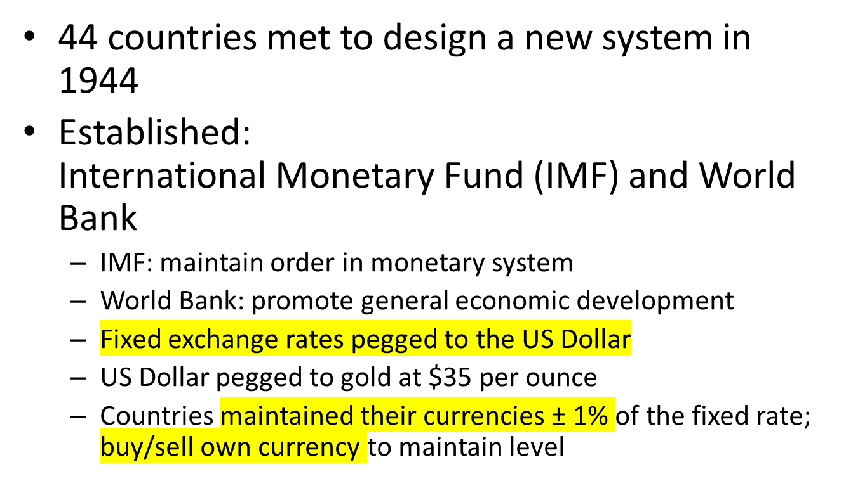
Bretton Woods (1944 - 1973)

Slide 29
The Bretton Woods System
The Role of the I M F
  Discipline
    A fixed exchange rate stops competitive devaluations and brings stability to the world trade environment.
    It also imposes monetary discipline on countries, thereby curtailing price inflation.
  Flexibility
    I M F is ready to lend foreign currencies to members to tide them over during short periods of balance-of-payments deficits.
    A country could devalue its currency by more than 10 percent if its balance of payments was in “fundamental disequilibrium.”
Notes:
Although monetary discipline was a central objective of the Bretton Woods agreement, it was recognized that a rigid policy of fixed exchange rates would be too inflexible. It would probably break down just as the gold standard had. In some cases, a country’s attempts to reduce its money supply growth and correct a persistent balance-of-payments deficit could force the country into recession and create high unemployment.
The system of adjustable parities allowed for the devaluation of a country’s currency by more than 10 percent if the IMF agreed that a country’s balance of payments was in “fundamental disequilibrium.” The term fundamental disequilibrium was not defined in the IMF’s Articles of Agreement, but it was intended to apply to countries that had suffered permanent adverse shifts in the demand for their products. Without devaluation, such a country would experience high unemployment and a persistent trade deficit until the domestic price level had fallen far enough to restore a balance-of-payments equilibrium. The belief was that devaluation could help sidestep a painful adjustment process in such circumstances.

Slide 30
The Bretton Woods System
The Role of the World Bank
  Initial mission was to refinance rebuilding of post-war Europe.
  Under International Bank for Reconstruction and Development (I B R D), money is raised through bond sales in the international capital market and borrowers pay a market rate of interest—the bank's cost of funds plus a margin for expenses.
  Under International Development Agency (I D A), loans go only to the poorest countries.
Notes:
The official name of the World Bank is the International Bank for Reconstruction and Development (IBRD).
When the Bretton Woods participants established the World Bank, the need to reconstruct the war-torn economies of Europe was foremost in their minds. The bank’s initial mission was to help finance the building of Europe’s economy by providing low-interest loans. As it turned out, the World Bank was overshadowed in this role by the Marshall Plan, under which the United States lent money directly to European nations to help them rebuild. The bank turned its attention to development and began lending money to third-world nations.

Slide 31
Collapse of the Fixed Exchange System
The system of fixed exchange rates established at Bretton Woods worked well until the late 1960’s
  The US dollar was the only currency that could be converted into gold
  The US dollar served as the reference point for all other currencies
  Any pressure to devalue the dollar would cause problems through out the world

Slide 32
Collapse of the Fixed Exchange System
Factors that led to the collapse of the fixed exchange system include
  President Johnson financed both the Great Society and Vietnam by printing money
  High inflation and high spending on imports
  On August 8, 1971, President Nixon announces dollar no longer convertible into gold
  Countries agreed to revalue their currencies against the dollar
  On March 19, 1972, Japan and most of Europe floated their currencies
  In 1973, Bretton Woods fails because the key currency (dollar) is under speculative attack

Slide 33
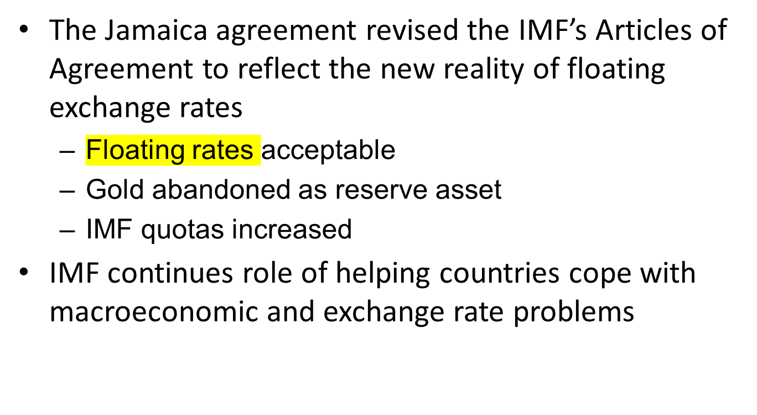
Floating Exchange Rates

Slide 34
Exchange Rates Since 1973
Exchange rates have been more volatile for a number of reasons including:
  Oil crisis -1971
  Loss of confidence in the dollar - 1977-78
  Oil crisis – 1979, OPEC increases price of oil
  Unexpected rise in the dollar - 1980-85
  Rapid fall of the dollar - 1985-87 and 1993-95
  Partial collapse of European Monetary System - 1992
  Asian currency crisis – 1997
  Euro Zone crisis—2010+
  Collapse of oil prices - 2014

Slide 35
Multiple Exchange Rates
Venezuela:
Basis Bolivars/$US
Official 4.3
Imports of food, medicine, etc. 2.3
Buying $US for business 5.3
Black Market 8.5 (2012)
17 (2013)
900 (2016)

Slide 36
Managerial Implications
Currency management
  Currency market does not always work as expected
  Government intervention
  Speculative activity
Business strategy
  Movements in exchange rates are difficult to predict
  Forward market is imperfect predictor of exchange rate movements
  Forward exchange rate market covers risk for months not years
  Maintenance of strategic flexibility required
    Disperse manufacturing
    Outsource
  Corporate-government relations

Slide 37

What’s next: Virtual Money?

Slide 38
End of Foreign Exchange and Monetary System Lecture

